Slide 1
CS/RBE 549 COMPUTER VISION
LECTURE 4 – DETECTION & BINARIZATION

Slide 2
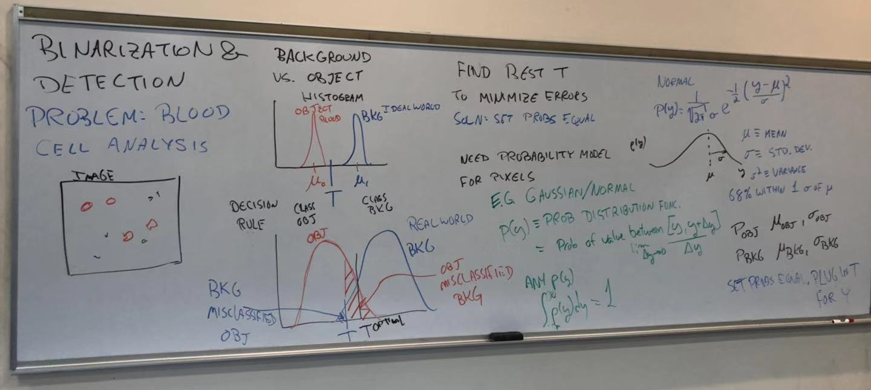

Slide 3
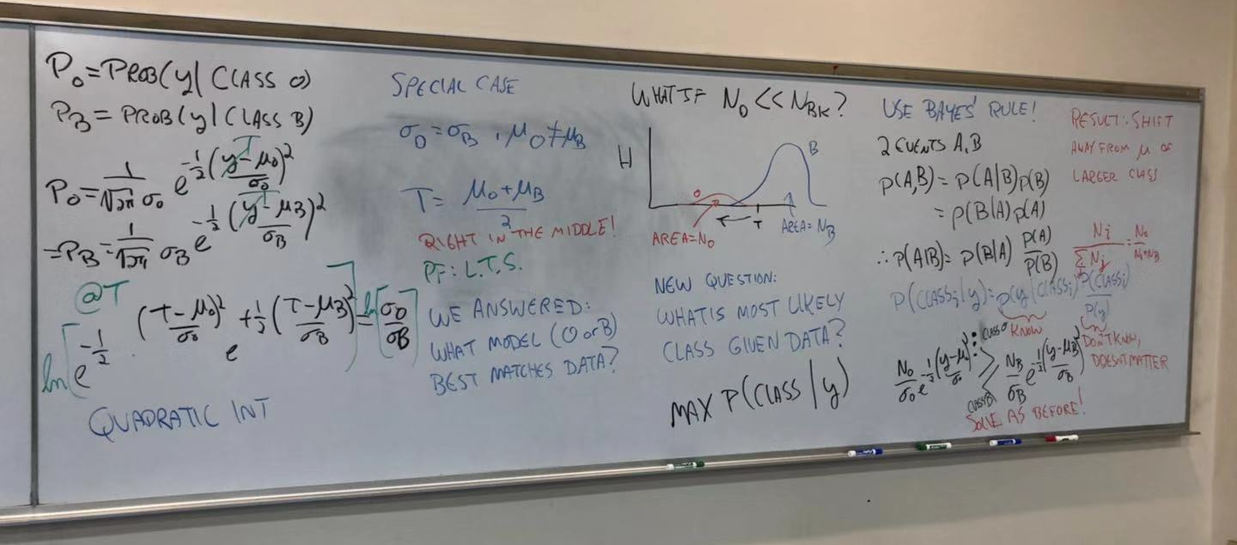

Slide 4
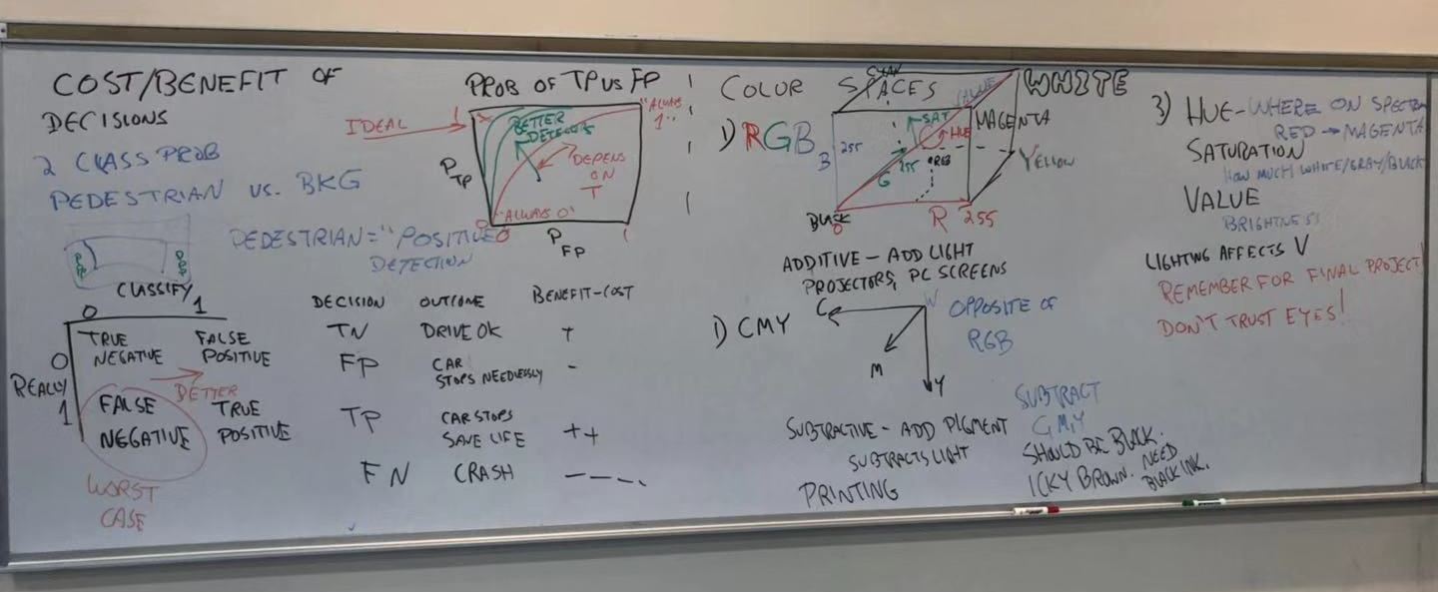

Slide 5
